Slide 1
CLOUD STORAGE
Bachelor of Engineering- Computer Science & Engineering
Cloud Computing (CC)(23CS009)
Department of Computer Science & Engineering
Chitkara University Institute of Engineering and Technology, Chitkara University, Punjab, India

Slide 2
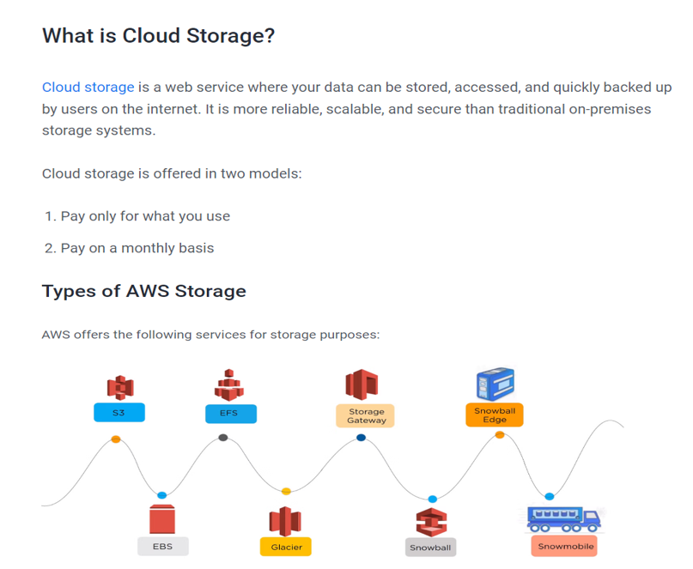
CLOUD STORAGE

Slide 3
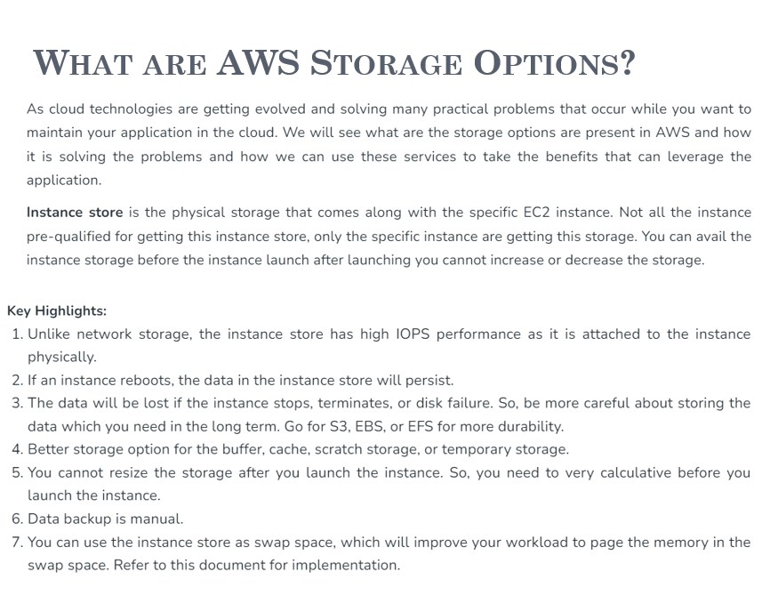
CLOUD STORAGE

Slide 4
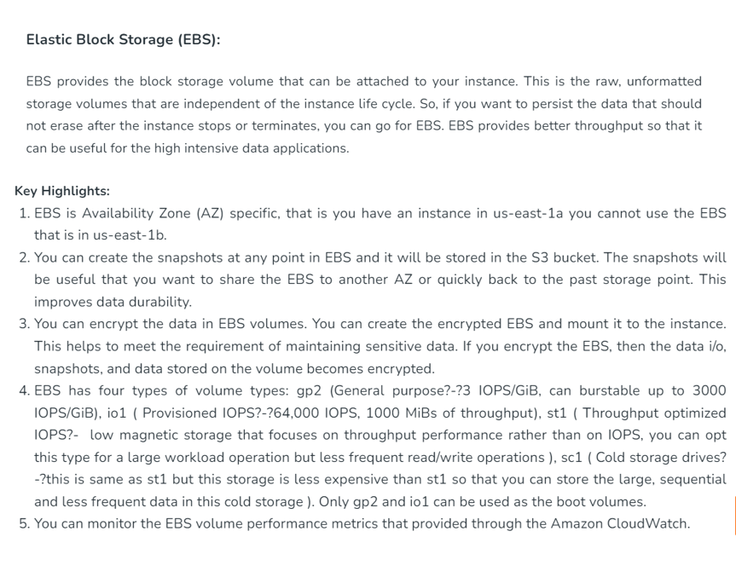
CLOUD STORAGE

Slide 5
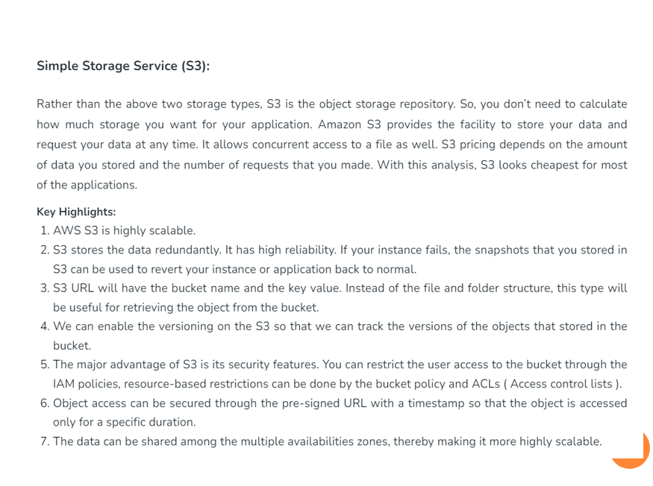
CLOUD STORAGE

Slide 6
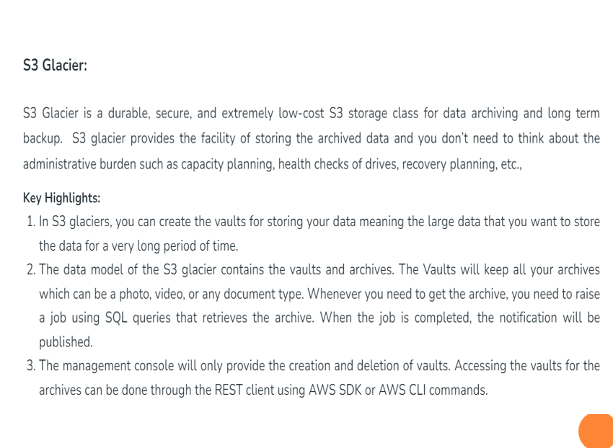
CLOUD STORAGE

Slide 7
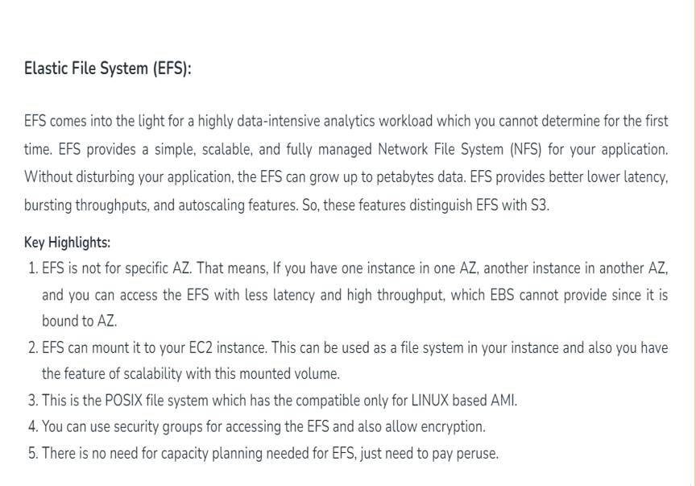
CLOUD STORAGE

Slide 8
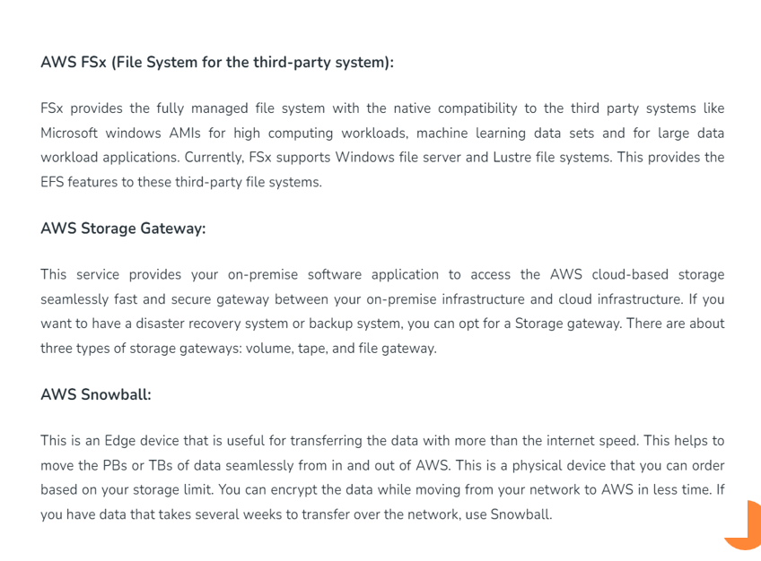
CLOUD STORAGE

Slide 9


